Slide 1
About us page
The trusted CPaaS - Kaleyra

Slide 2

THE TRUSTED MEDICAL TOURISM COMPANY AS AN ASSISTANT
Omnichannel Medical Assistance
Marlin medical assistance is an award winning & professionally managed company to provide the best treatment at affordable price, personalized care and more
About Us
Contact Us

Slide 3
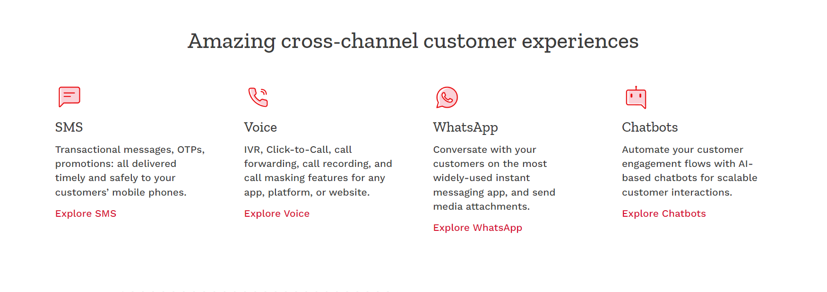
Amazing patients experiences in and outside hospital
Trusted doctors- Treatment by highly qualified doctors and superb surgeons who have performed the most intricate surgeries; they are proficiently skilled, well experienced.
Top Hospitals- JCI & NABH accredited hospitals with an expert medicine intelligentsia, outdo technology, and most upright medical & health care infrastructure
Prompt care- Caters to the needs of Ministry of Health, Insurance Companies, Third Party Administrators and individuals seeking right and affordable Treatment
Hassle-free support- Finding right doctors, cost effective packages, help in hospitalization and cost comparison among multiple doctor and hospital choices.
Best Assistance- 24x7 Medical Assistance with 100% surety of after care

Slide 4
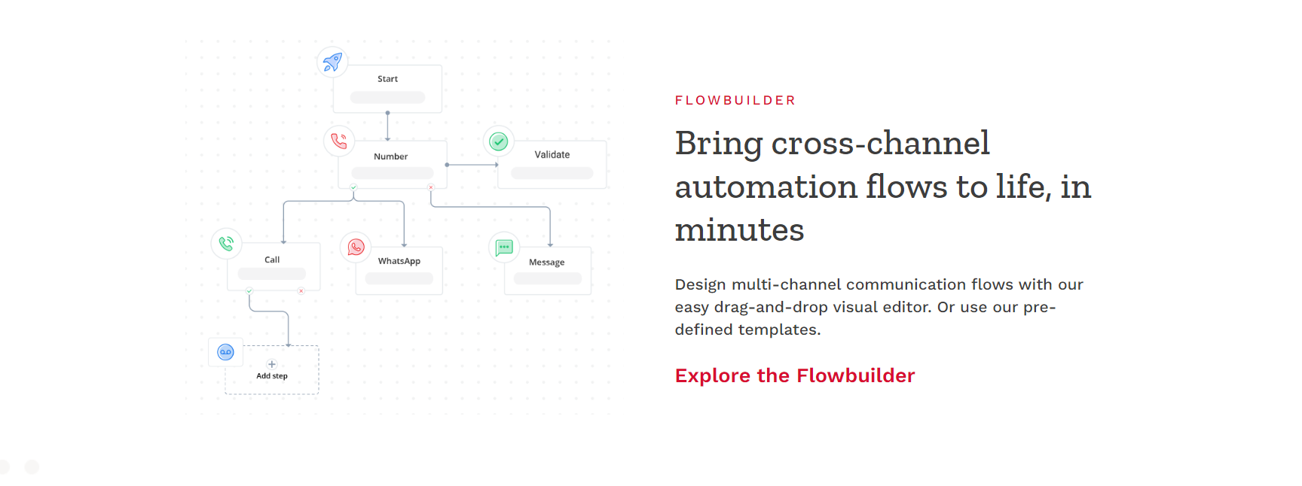
Finder Flow
Bring world-class treatment and personalized medical support to you, just in a click
Choose from different hospital, doctors and treatment plans with our easy step-by-step finder. Or ask us personalized treatment plan according to your disease from our trusted doctors and healthcare assistant.

Slide 5
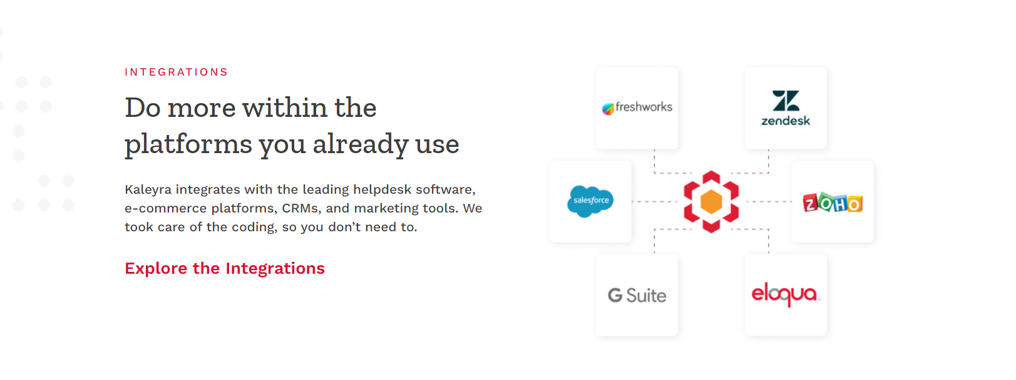
PACKAGYNIC
Save up to 50% within the treatment you already plan
Marlin brings affordable price from leading hospitals, doctors and specialized clinics to prepare best healthcare packages. These packages took care of the accommodation, transportation and sigh-seeing also in unmatched price for you and your love ones, so you don’t need to worry.
Explore the packages

Slide 6

Why Marlin Medical Assistance?
Our Organisation work on a formula called 4As which is very effective in order to comfort our patients
Accuracy- Our support team are right here to assure to provide accurate and right treatment and support services 24/7.
Accountability- We offer enterprise-grade privacy to patients in highly-regulated sectors.
Affordability- Our tech-base solution allows patients to find best doctors and hospitals in affordable cost, without limits.
Aftercare- Most proficient & quick medical opinion and proper care when you return back to your country.

Slide 7
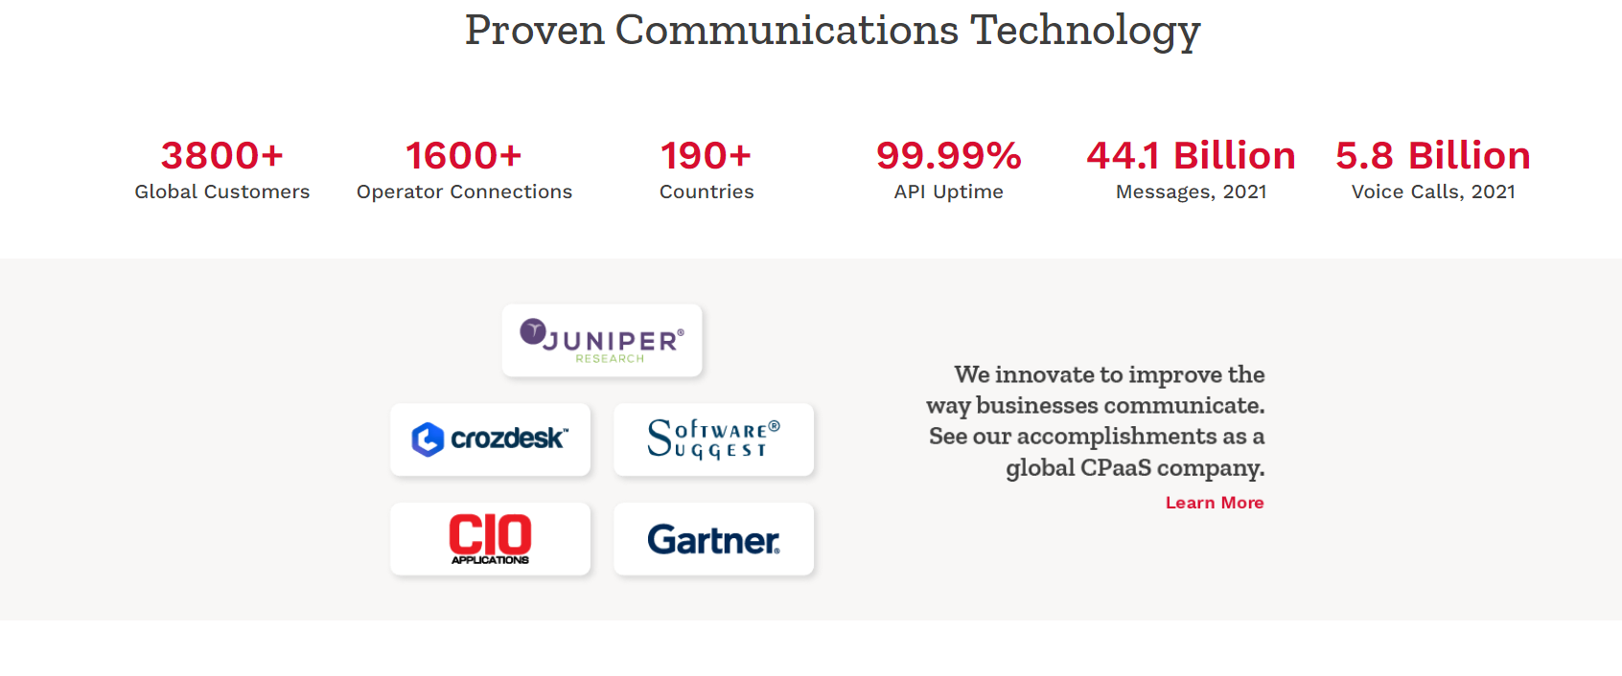
Proven Medical Assistance
3800+ 600+ 50+ 99.99% 10 Million
Global Patients Hospital connections Countries Infection rate Visitors, 2021
Marlin innovates to improve the way patients choose doctors and hospitals by providing them latest heath care information. See our accomplishments as a global medical assistance company.

Slide 8

Marlin wins ‘Best Medical Tourism Company’ at the Indian Excelsior Awards 2021
Marlin was named the ‘Best medical tourism company’ at a glitzy award night named Indian Excelsior Awards 2021 at Carol Queen Cruise, Panjim, Goa on 20th March 2021. The evening was graced by the Rock On!! Star, Prachi Desai to felicitate the honorable awardees.
Read more

Slide 9
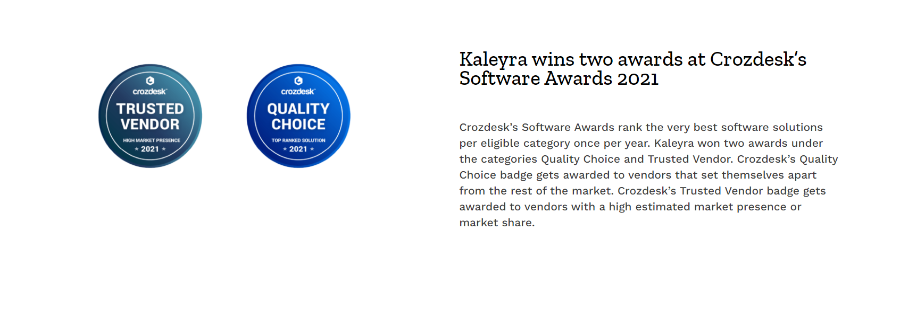
Marlin wins Best Medical Tourism Company awards 2019
Marlin is awarded Best Medical Tourism Company of the year 2019 in a glittering gala show of “Global Healthcare & Medical Tourism Conclave and Expo” at ITC Maratha Palace, Mumbai, India for its continuous efforts for betterment of international patients’ treatment in a decade.

Slide 10
Blindwink Honors the CEO of Marlin at India Excellence Awards - 2021
Blindwink has honored Dr. Mohammad Afzal Siddiqui, CEO of Marlin Medical Assistance for his consistently excelled work in the turbulent times through revolutionary ideas & tireless efforts. India Excellence Awards are designed to reward the most deserving individuals & institutions through a comprehensive analysis of the information gathered from the nominees.
Read more

Slide 11
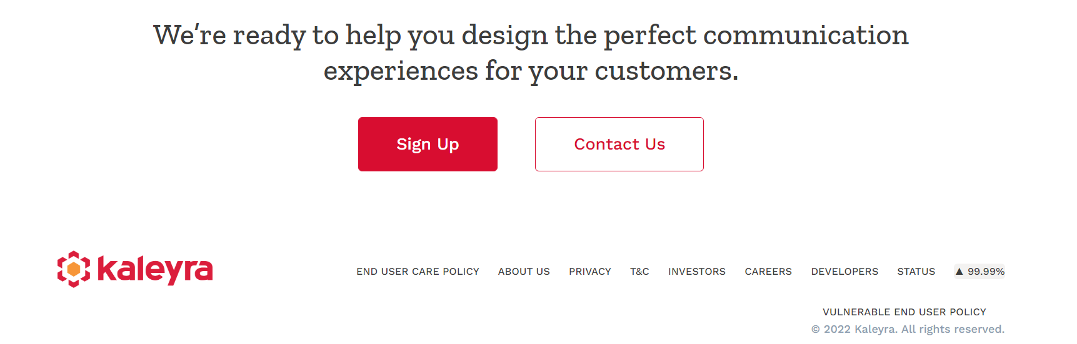
We’re ready to help you find the perfect medical treatment for your disease.

Slide 12
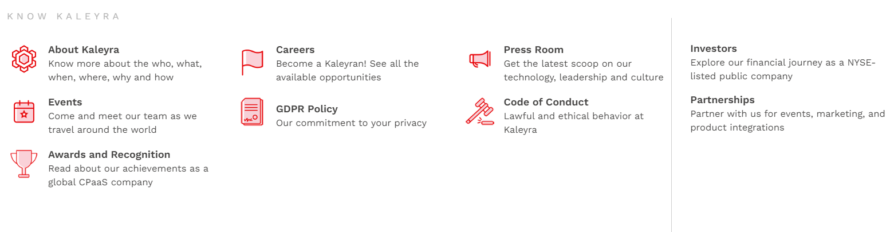
Our Goal is to promote and protect our patients health and well being, our services are meant to improve the quality of their lives
Marlin Medical Assistance is recognized for providing high quality, comprehensive medical treatment as a consequences of our superior medical and customer service standards

Slide 13
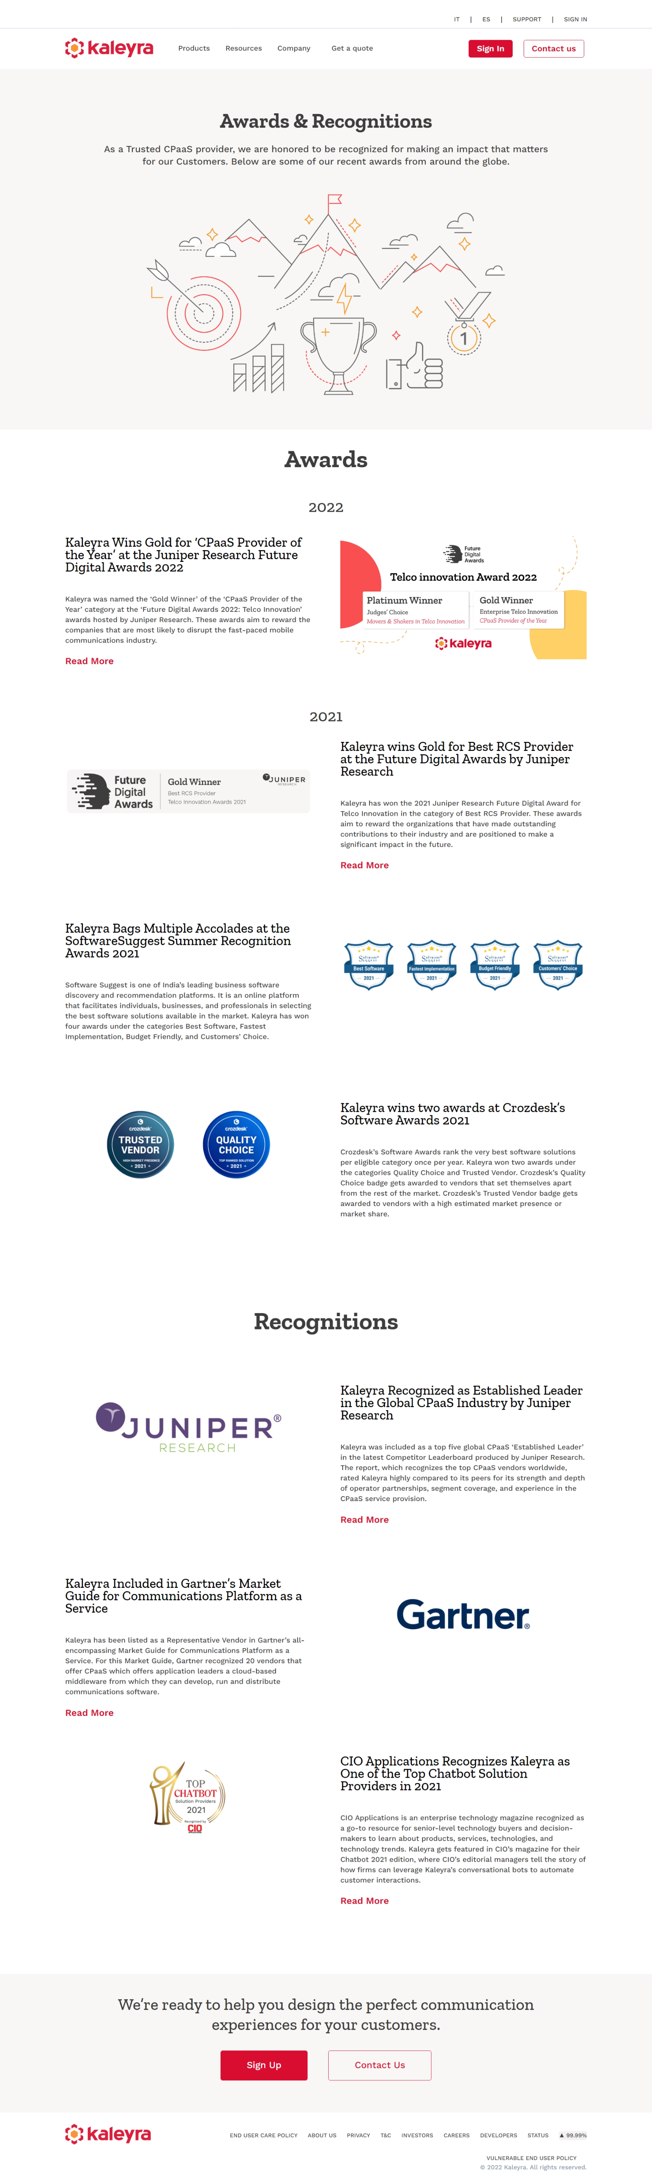
Awards and Recognition - Kaleyra

